Slide 1
Real-time Rendering of 3D Fractal Geometry
Dissertation Online Presentation
Solomon Baarda

Slide 2
Project Recap
Challenging and interesting topic
Real world value and application
Aims and objectives
Flexible scope with stretch goals
Requirements analysis
Risk analysis
Project plan and timeline

Slide 3

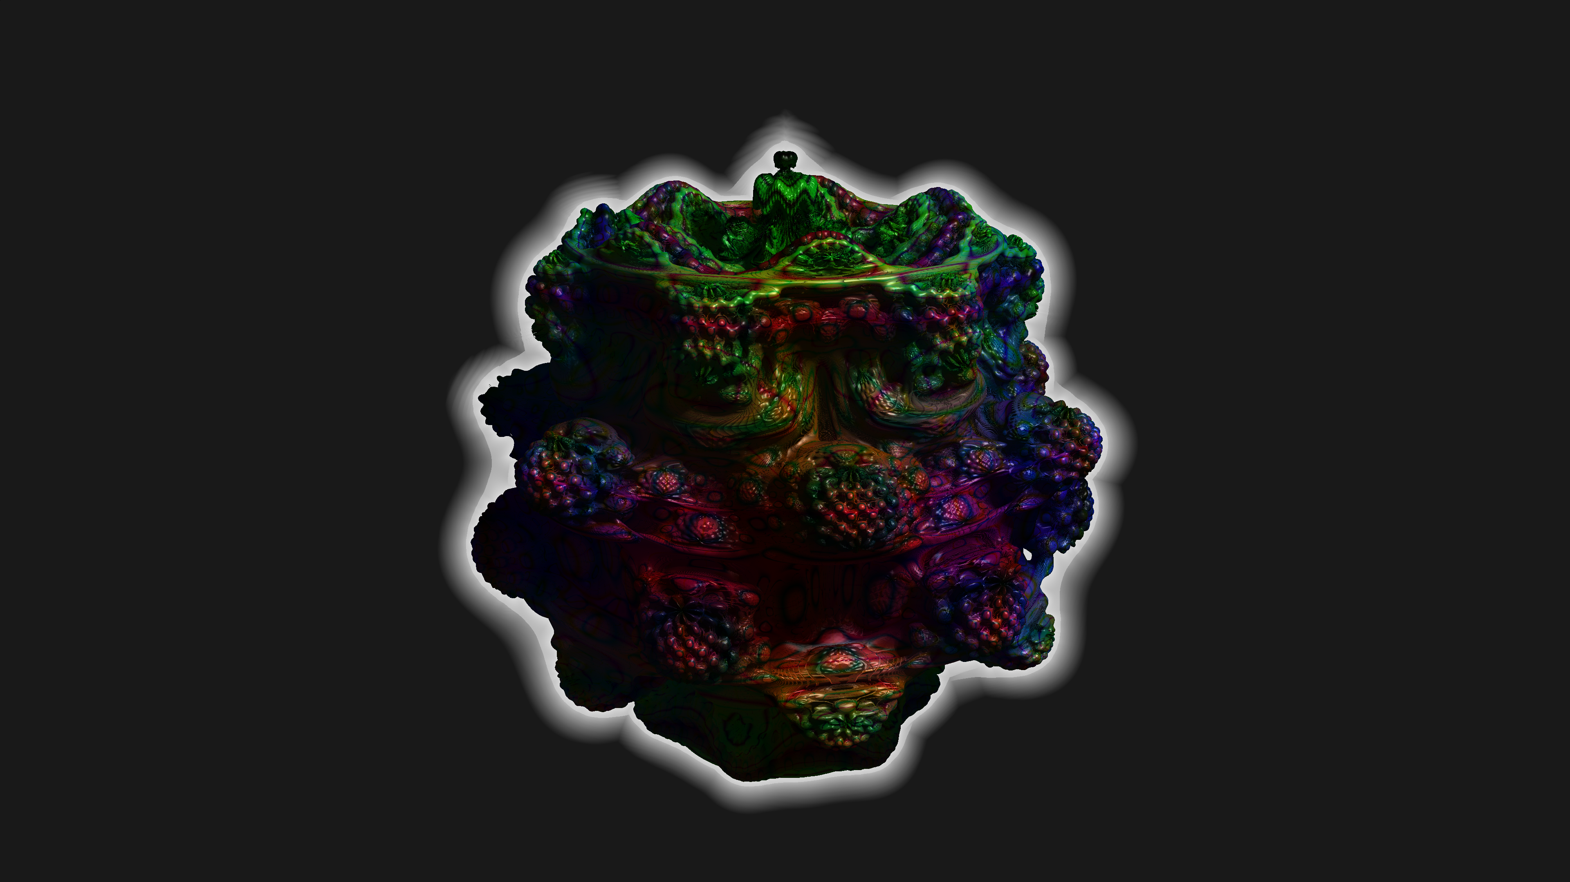
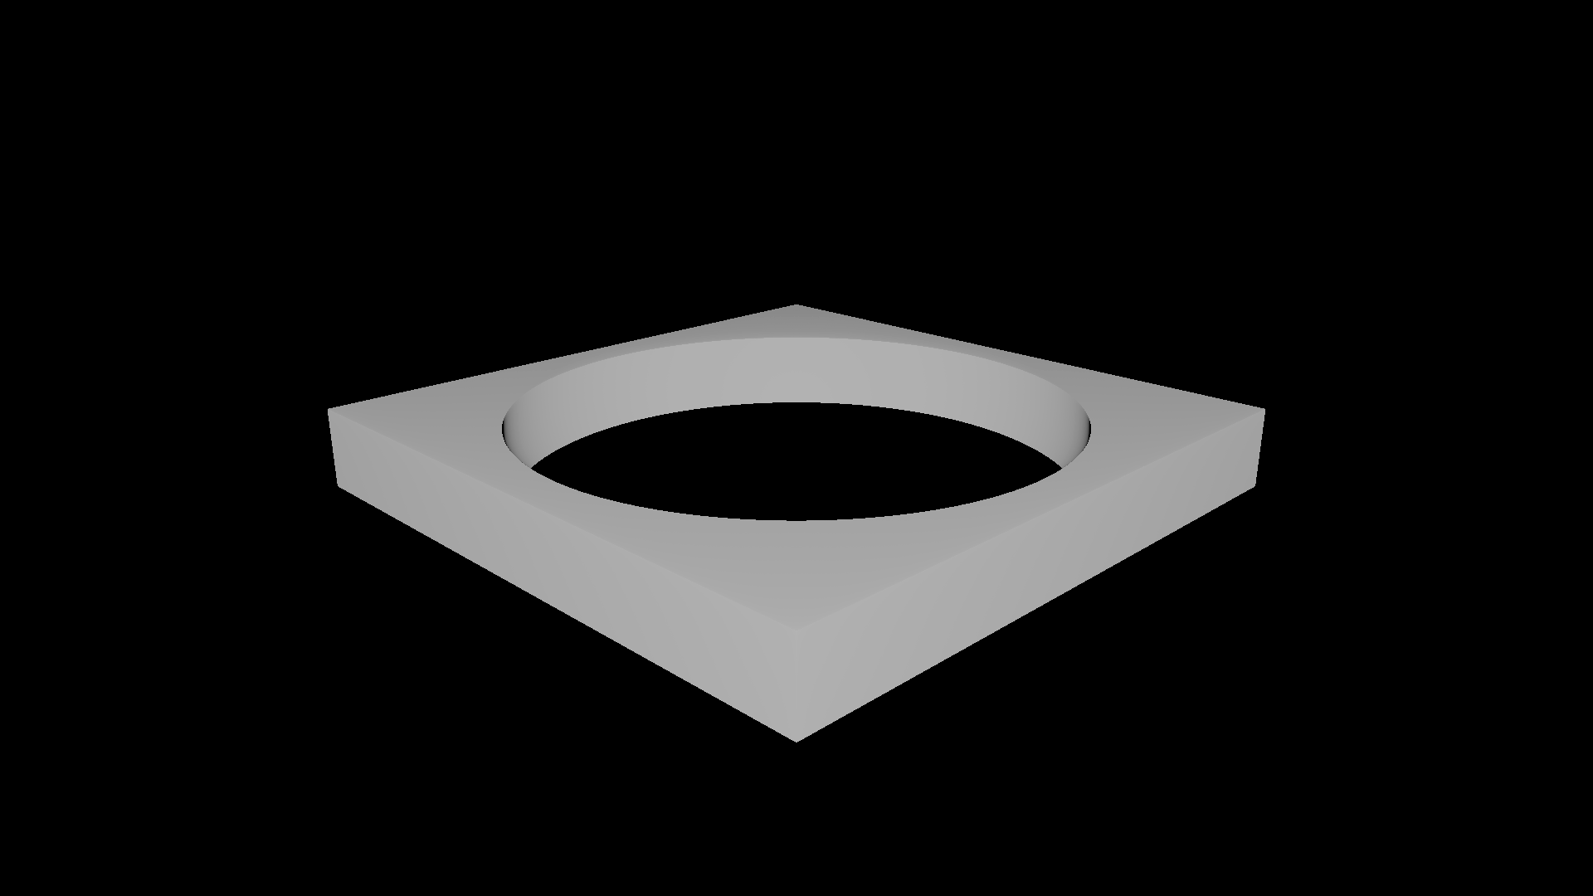
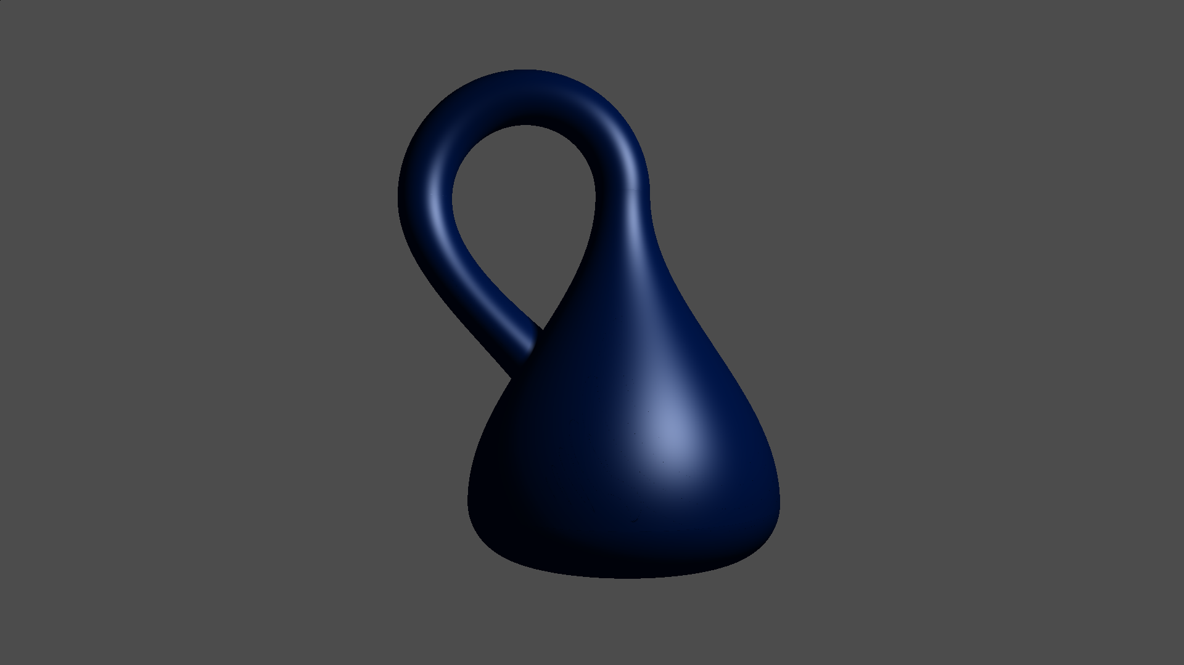
Work Completed
Created a real-time rendering engine for signed distance functions (SDFs)
This enables rendering of 3D fractals, Constructive Solid Geometry (CSG-models), and algebraic/meta-surfaces

Slide 4
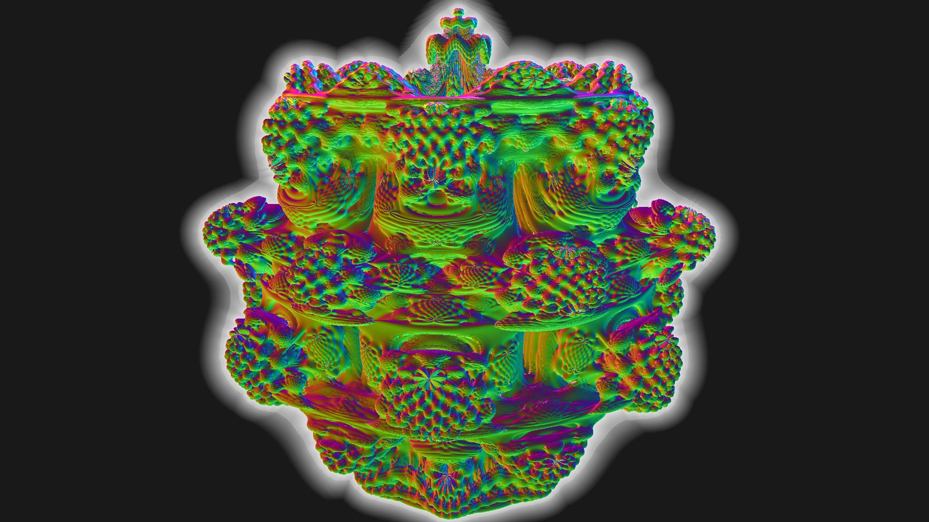
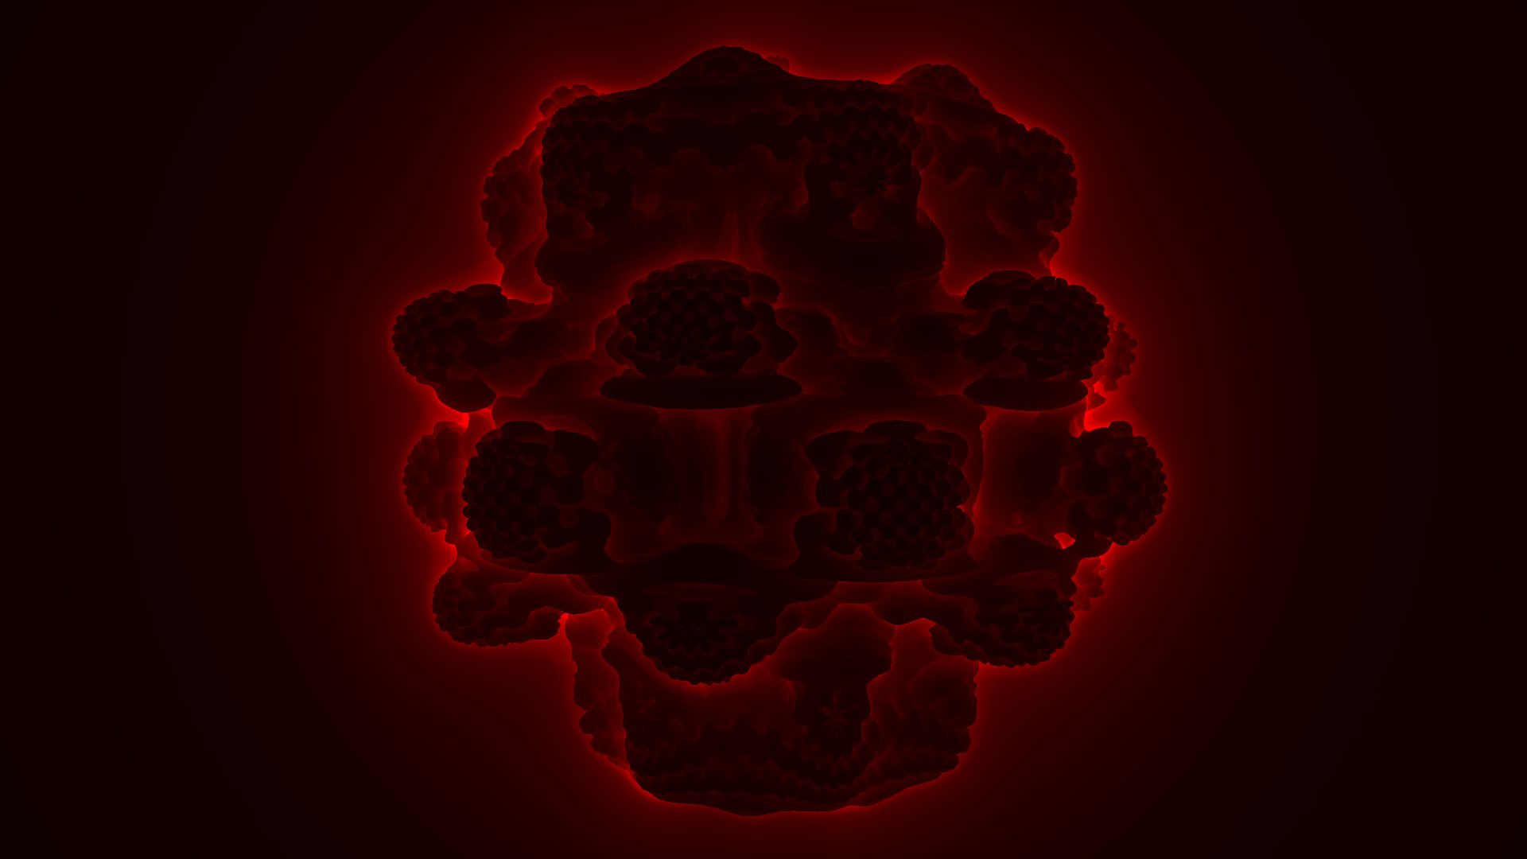

Additional Work Completed
Updated image gallery
Added debugging tools section to documentation
Added Klein bottle scene

Slide 5
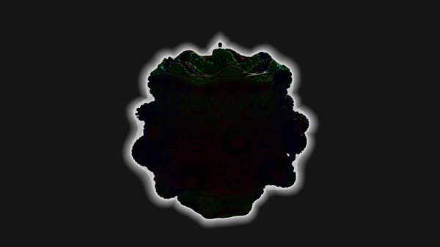
Application Evaluation
Performance benchmarking to analyse the value of optimisations and visual features, and analyse scalability over different systems
Brief discussion of visual artifacts
Unit tests for application code correctness

Slide 6
Project Evaluation
Achieved/not achieved status for implementation of requirements
Goal based evaluation strategy for aims and objectives
Comparison with existing literature

Slide 7
Future Work
Licensed using the General Public License 3.0
GitHub repository for version control
developer and user documentation
Image gallery containing screenshots and videos of the application

Slide 8
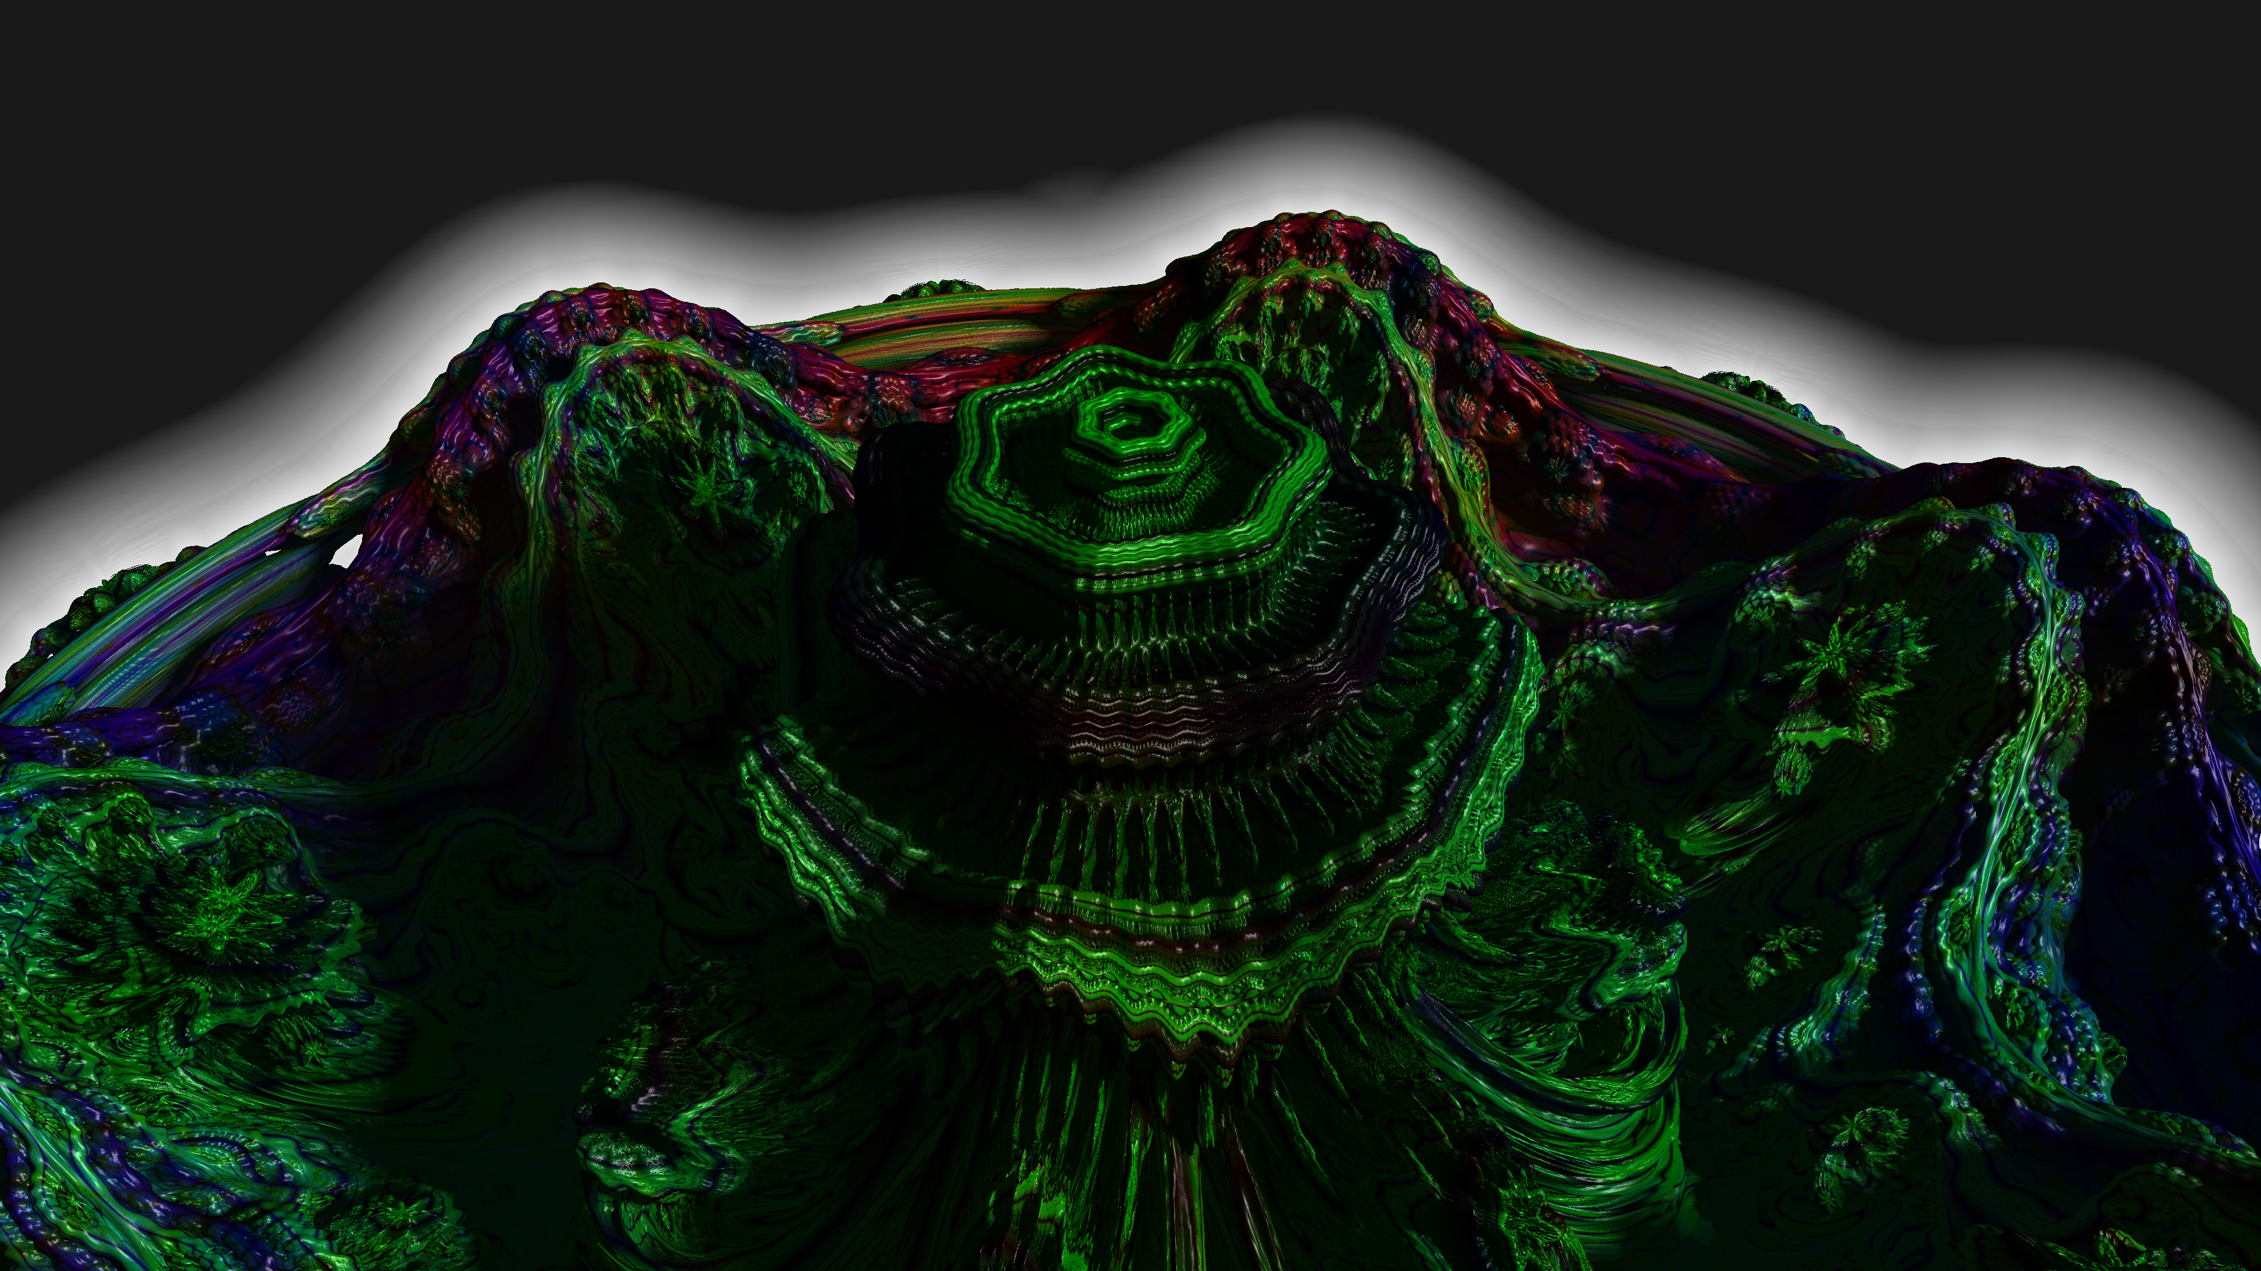
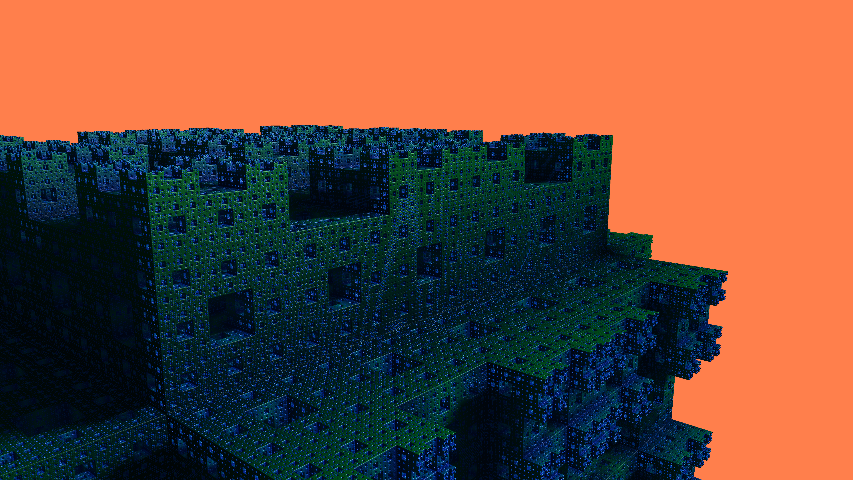
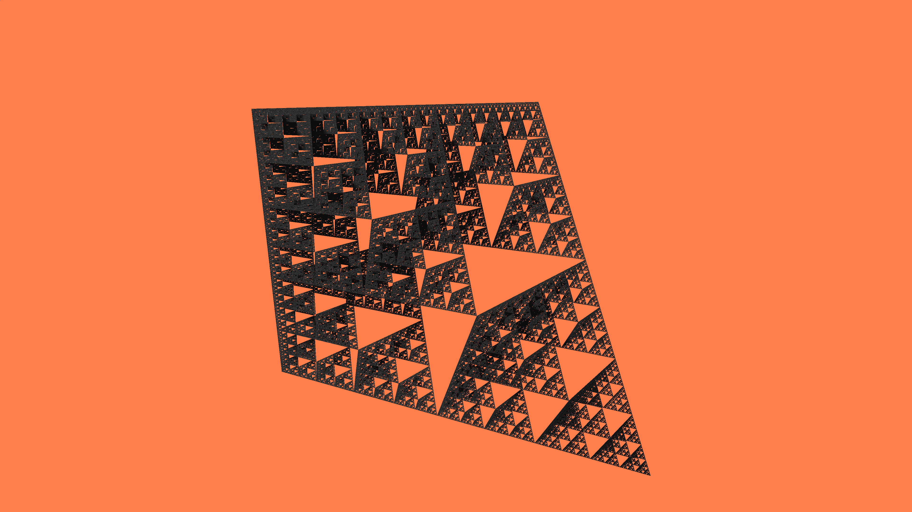

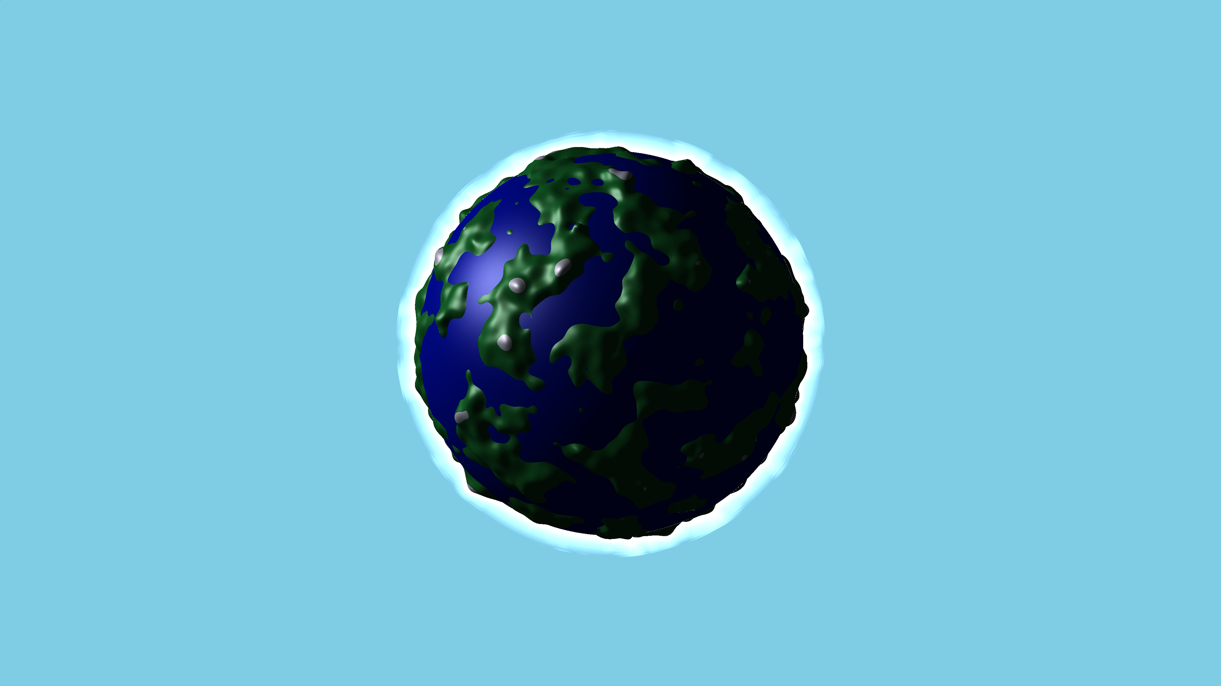
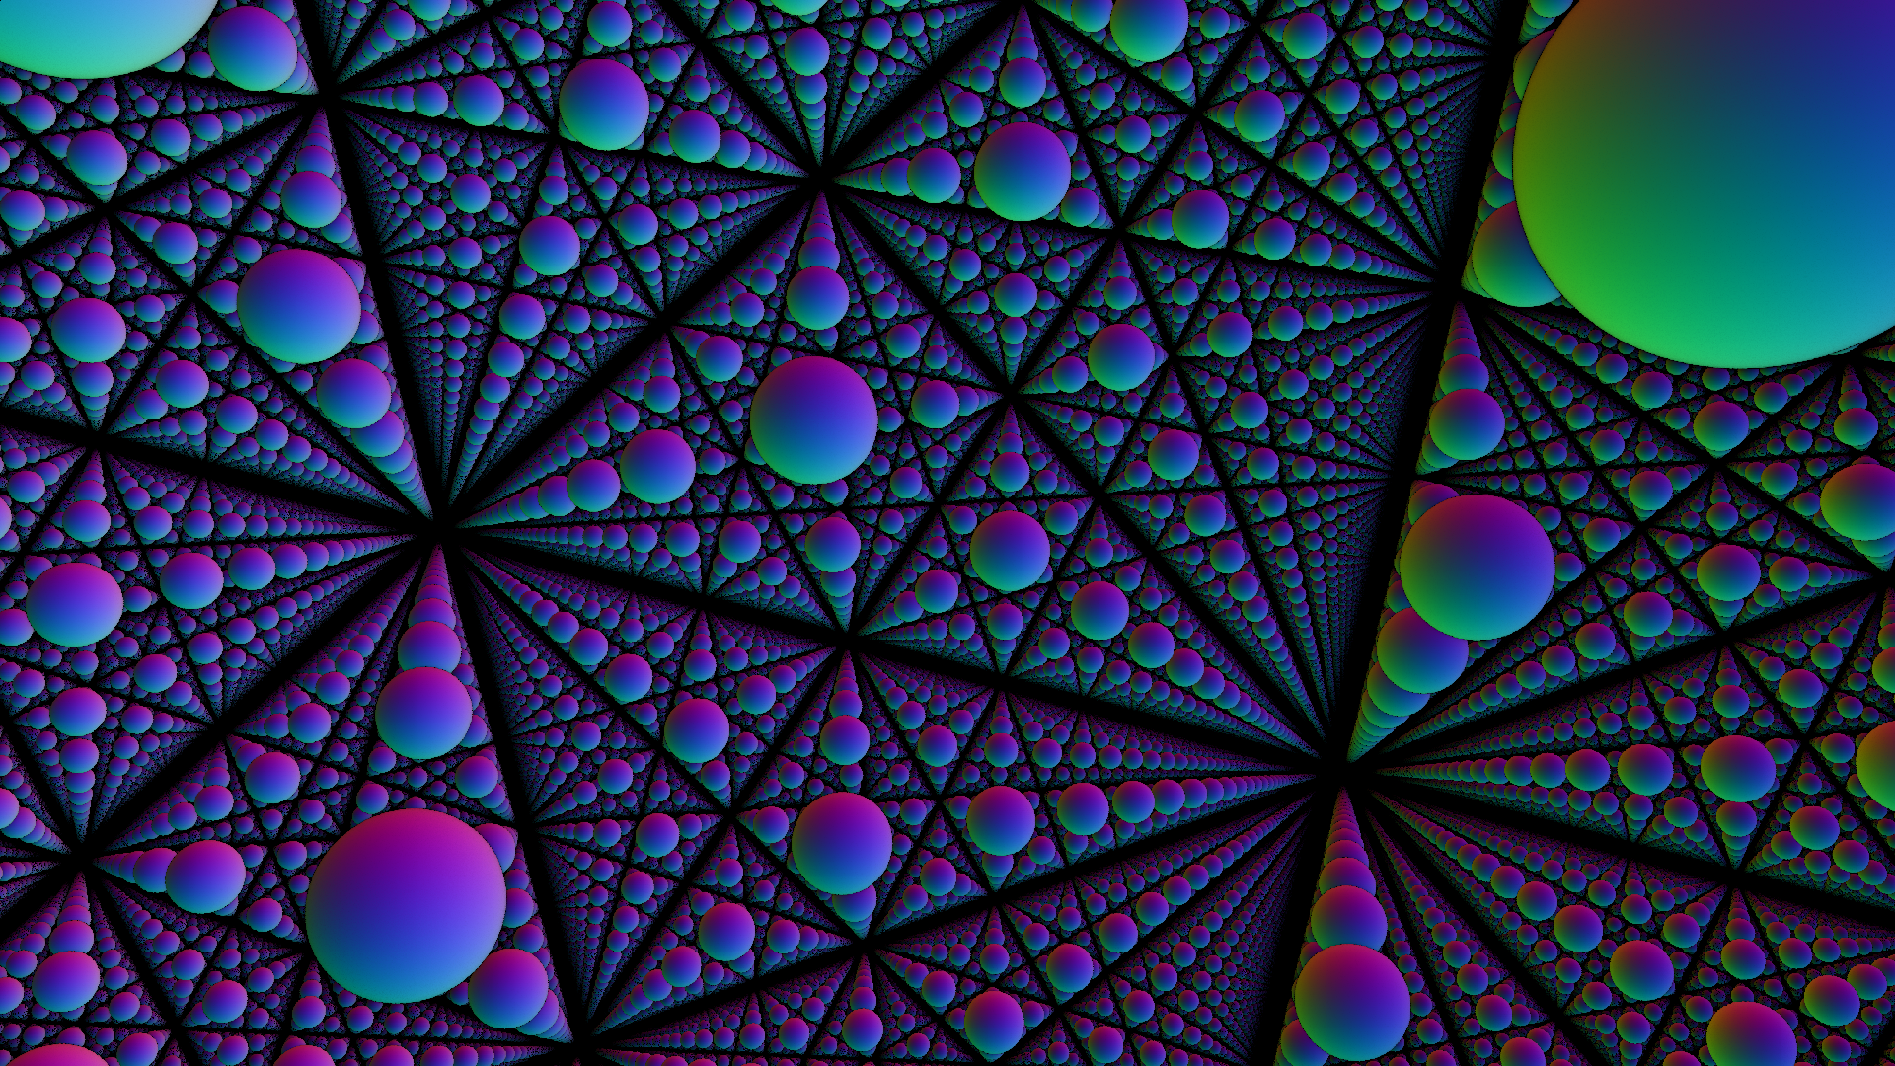
Thank you for your attention Any questions?

